Slide 1
9/30 Daily Catalyst Pg. 22 Evolution Theory
1. Who is the father of evolution?
2. Describe Darwin’s Theory of Evolution.
3. What island influenced Darwin’s theory?
4. Why was Darwin’s theory so controversial at the time?

Slide 2
9/30 Class Business Pg. 21 Evolution Theory
Quiz #6 Evolution on Thursday
Special chemistry on Friday with LSU students
Ecology Test data:
If you earned a score of a “D” or “F”, you must get your test signed by your parent/guardian for test corrections
Test corrections are due Friday
 | 3rd
Average | 54%
Top Scorers | James (2.9) Travia (1.5)

Slide 3
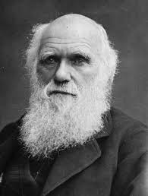
9/30 Agenda Pg. 21 Evolution Theory
Daily Catalyst
Class Business
Intro to Evolution
Darwin’s Theory

Slide 4
9/30 Objective
Analyze Darwin’s theory of Evolution

Slide 5
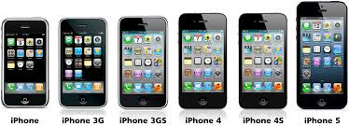
Evolution Unit #3
Notes:
Tell me about the evolution of the iphone? Why has it changed over the years? What has caused it to change?

Slide 6
Turn and Talk
Why do organisms evolve?
Prokaryotes and Eukaryotes
Notes:
Have students turn and talk to their neighbors about why organisms evolve. Remind students to include both euks and proks.

Slide 7
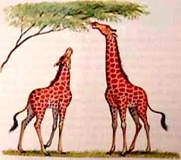
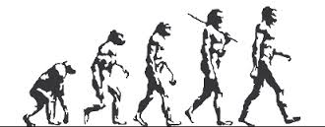
Evolution
Key Point #1:
Evolution: the process of changing over time
How do we know what organisms used to look like to determine if change has occurred?

Slide 8
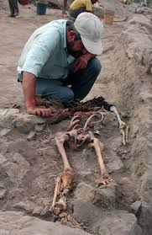
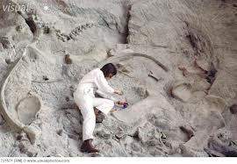
Science is Awesome!
Archaeologist:
a specialist in archaeology, the scientific study of prehistoric peoples and their cultures by analysis of their artifacts, inscriptions, monuments, etc.
Notes:
The importance of different types of scientists come together to look at the evidence from the past by looking at bones, fossils, and changes in vegetation to come to a conclusion.

Slide 9
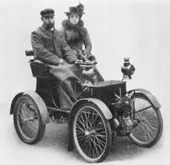
Before Darwin…
Before Darwin published his Theory of Evolution, the public did not believe in evolution.
Society believed organisms on earth had stayed the exact same as the day they were created.

Slide 10
Linnaeus's Taxonomy theory (1770)
Write ONE key point under Linnaeus's paragraph
Key Point #2:

Slide 11
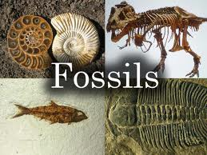
Fossils
Throughout the 1700’s, as paleontology become more popular and accepted, scientists were observing that fossils they found did not belong to organisms that lived on the earth at the time.
What happened? Change?

Slide 12
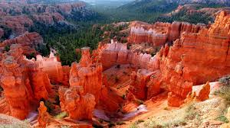
Geology
Along with fossils, geology (study of the earth) was the foundation for the thought of evolution.
Scientists observed the earth changing (evolving) SLOWLY over time
Could Organisms do this??

Slide 13
Lamarck’s Theory
Read Lamarck’s Theory
Write ONE key point under Lamarck’s Theory
Key Point #3:

Slide 14
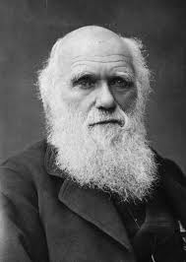
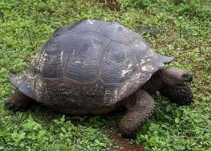
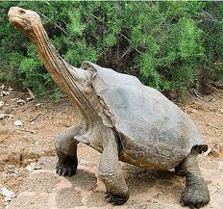
Charles Darwin
In the 1830’s Darwin traveled to the Galapagos Islands and studied the different animals and plants among the islands.
Notes:
The dome shaped tortoise has a shorter neck since vegetation on the island is closer to the ground. The saddle-backed tortoise has a longer neck since the vegetation is sparse, it must be able to reach up to food.
At this time, people believed that all animals and plants had stayed the same since they were created. It was Darwin that started the idea that life changes through time as our environment changes.

Slide 15
Video clip
http://www.sciencechannel.com/video-topics/earth-science/galapagos-beyond-darwin-charles-darwin.htm

Slide 16
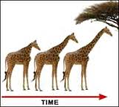
Darwin’s Theory of Evolution
Darwin first proposed his Theory of Evolution in the 1850’s.
He believed organisms changed over time.
Why would organisms change?
Organisms change TO SURVIVE AND REPRODUCE!

Slide 17
http://www.sciencechannel.com/video-topics/earth-science/galapagos-beyond-darwin-charles-darwin.htm

Slide 18
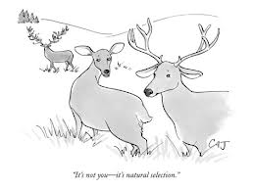
Darwin’s Theory of Evolution
Darwin believed organisms evolved by a mechanisms called NATURAL SELECTION.
Key Point #4: Natural Selection:
Naturally breeding for desired traits.

Slide 19
In other words…
Key Point #5:
**Natural selection is survival of the fittest**

Slide 20
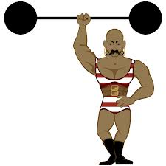
Fitness
I am not talking about strength!
Fitness: to survive and have lots of babies! (Pass on those traits)

Slide 21
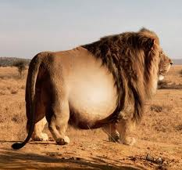
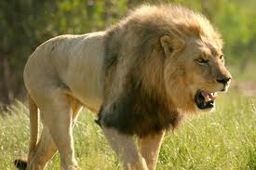
Which lion will be king?
Notes:
The lion on the left is fit and strong. He will be able to fun faster and catch prey and defend his pride. This lion will go on to reproduce and make lion cubs.

Slide 22
Read page 444
Key Point #6:
Three important notes from this reading

Slide 23
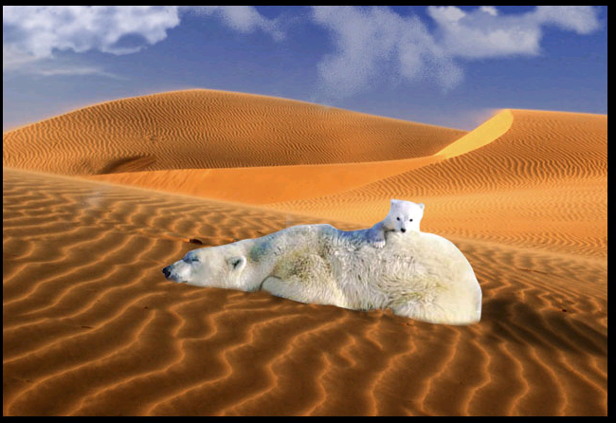
Important!
Key Point #7: Some traits can increase survival in one environment, but not another.
Fur coat in the desert= not helpful
Notes:
A polar bear’s fur coat will insure survival in the frozen Antarctic, but a fur coat in the desert is not helpful to the polar bear and will not help the polar bear to survive.

Slide 24
Natural Selection Example
-In any population, there are differences between species.
AKA: different traits
For example - These fish are
different sizes, shapes and
speeds.

Slide 25
Natural Selection Example
-Organisms with helpful traits such as being fast, survive better in their environment than slow fish.
Since they are alive
longer they have more
time to have babies and
spread their genes!

Slide 26
Natural Selection Example
-Over time, only the organisms with the good traits (in this example, fast fish) will survive and reproduce and the new population of fish will have the fast trait!
Ancestors (Great-Grandparents)
New population of fish

Slide 27
How do organisms survive in different environments?
They ADAPT!
Darwin believed natural selection causes organisms to adapt→ evolve to better survive
What is an adaptation?

Slide 28
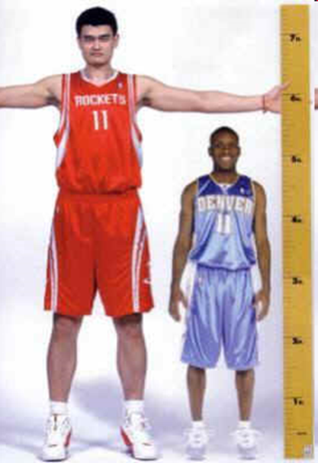
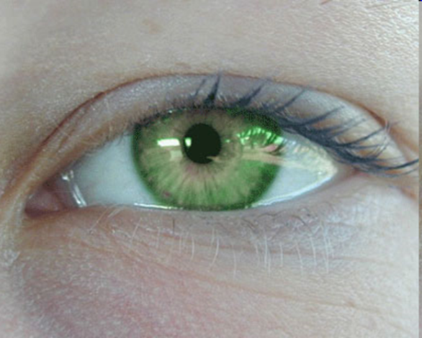
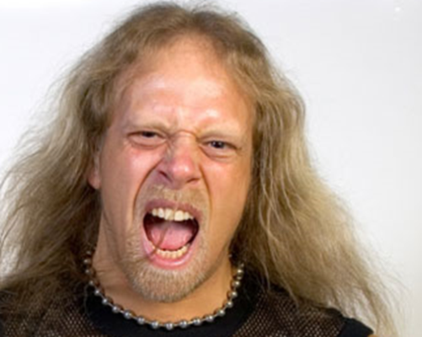
Key Point #8: Adaptations are heritable traits…
Heritable: passed on from parents to offspring by DNA.
Examples:
Notes:
Eye color, skin color, hair color, height

Slide 29
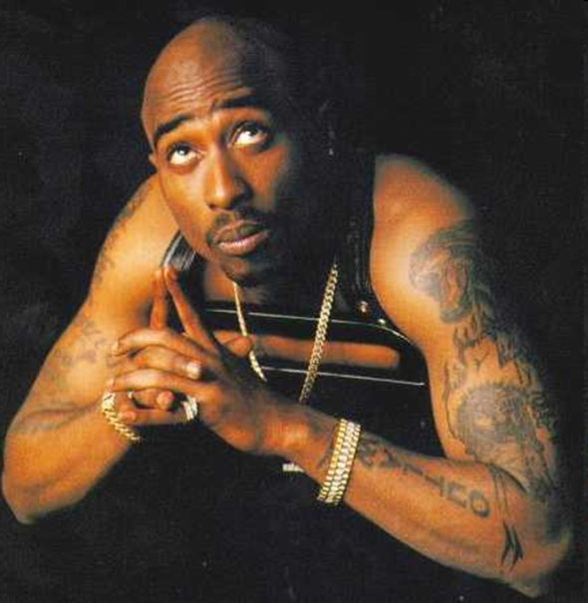
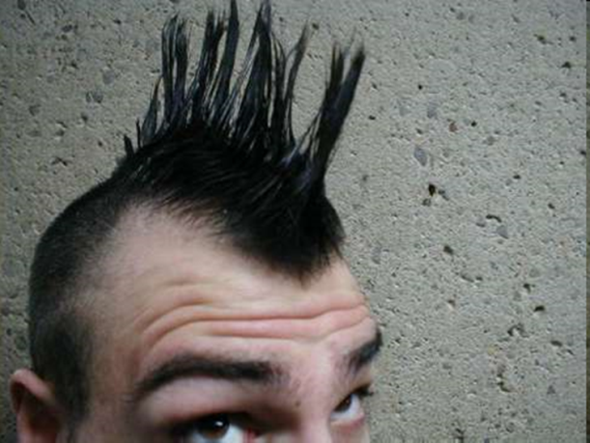
Not all traits are passed down from you parents.
Examples:
Notes:
Tattoos, hair style, music choice, favorite food

Slide 30
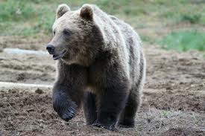
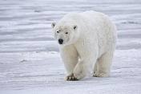
…and increase a species ability to survive and reproduce.
Key Point #8: Adaptations are heritable traits and increase a species ability to survive and reproduce.
Notes:
Both of these animals are bears, but they are very different in that, polar bears have adapted to the snowy environment and have white fur, brown bears on the other hand have brown fur and blend in to the mountainous environment.

Slide 31
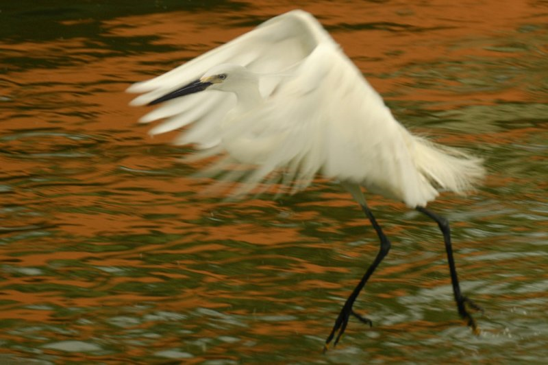
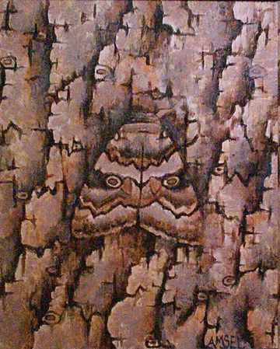
Adaptation Examples:
Moth Coloring
Bird Wing

Slide 32
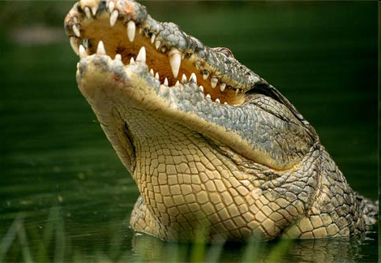
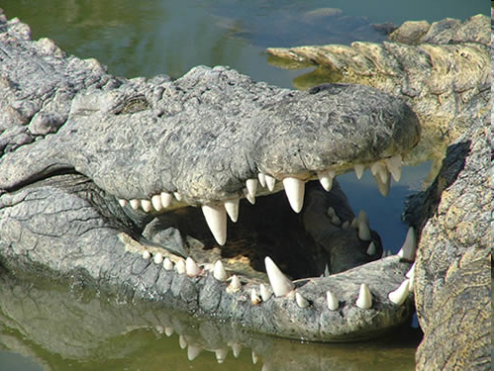
Example: Crocodile Teeth
Crocodiles have sharp, pointed teeth.
The shape of their teeth is heritable.
Having sharp, pointed teeth helps them to survive in their specific environment.
So, it is an adaptation.
Notes:
How does it help them survive? Ask students.

Slide 33
Four principles
Notes:
Why would one overproduce? So there is a greater chance of babies surviving on passing on the line.

Slide 34
Homework
Answer the following sentence in a 3-5 complete sentences in your notebook on pg. 21. I will check this tomorrow.
Why is natural selection more of an editing process than a creative one?
Notes:
Natural selection cannot create beneficial traits on demand, but “edits” variation in a population by selecting for those traits that work best in current environment.

Slide 35
10/1 Daily Catalyst Pg. 23 Natural Selection
1. List 3 density-independent factors that will affect the savanna biome.
2. How was Lamarck’s theory different from Darwin’s?
3. Why do you believe Darwin received so much criticism for his theory?

Slide 36
10/1 Daily Catalyst Pg. 23 Natural Selection
1. List 3density-independent factors that will affect the savanna biome.
Drought, famine, and lightning storms- fires
2. How was Lamarck’s theory different from Darwin’s?
Lamarck believed in acquire desired traits and Darwin believed in changing over a long period of time (Darwin was missing the genetic component).
3. Why do you believe Darwin received so much criticism for his theory?
Darwin received criticism for his theory because up until this point, people had not challenged the teachings ogf the church and the bible. The bible reinforced the ideas that all organisms were perfect and were the exact same as the day they were created.

Slide 37
10/1 Class Business Pg. 23 Natural Selection
Evolution Debate on Wednesday, Oct. 8th
Quiz #7 Evolution is Thursday
Evolution Test on Friday, Oct. 10th
Study guide due test day
Materials/methods are due Friday

Slide 38
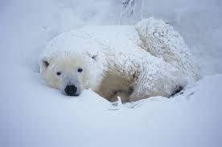
10/1 Agenda Pg. 23 Natural Selection
Daily Catalyst
Class Business
Darwin’s Theory
Fossils
Work time

Slide 39
10/1 Objective
Analyze Darwin’s theory of Evolution

Slide 40
Evolution Unit #3
Notes:
Tell me about the evolution of the iphone? Why has it changed over the years? What has caused it to change?

Slide 41
Key Point #8: Adaptations are heritable traits…
Heritable: passed on from parents to offspring by DNA.
Examples:
Notes:
Eye color, skin color, hair color, height

Slide 42
Not all traits are passed down from you parents.
Examples:
Notes:
Tattoos, hair style, music choice, favorite food

Slide 43
…and increase a species ability to survive and reproduce.
Key Point #8: Adaptations are heritable traits and increase a species ability to survive and reproduce.
Notes:
Both of these animals are bears, but they are very different in that, polar bears have adapted to the snowy environment and have white fur, brown bears on the other hand have brown fur and blend in to the mountainous environment.

Slide 44
Adaptation Examples:
Moth Coloring
Bird Wing

Slide 45
Example: Crocodile Teeth
Crocodiles have sharp, pointed teeth.
The shape of their teeth is heritable.
Having sharp, pointed teeth helps them to survive in their specific environment.
So, it is an adaptation.
Notes:
How does it help them survive? Ask students.

Slide 46
Homework
Answer the following sentence in a 3-5 complete sentences in your notebook on pg. 21. I will check this tomorrow.
Why is natural selection more of an editing process than a creative one?
Notes:
Natural selection cannot create beneficial traits on demand, but “edits” variation in a population by selecting for those traits that work best in current environment.

Slide 47
Four principles
Notes:
Why would one overproduce? So there is a greater chance of babies surviving on passing on the line.

Slide 48
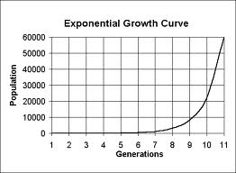
Darwin’s theory of Natural Selection
There are 4 parts to Darwin’s theory:
Key Point #1: Overpopulation: Populations grow exponentially, over populate and exceed their resources.
What is the result?
Competition for those resources!
Notes:
What does the growth curve look like?

Slide 49
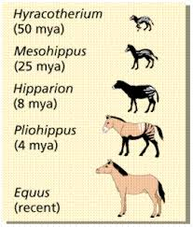
Key Point #2: Descent with modification: Over time, organisms have slowly changed to allow for better survival.
Notes:
Darwin did not explain this theory of variation and how various traits come to be. This would be the work of Gregor Mendal about 40 years later.

Slide 50
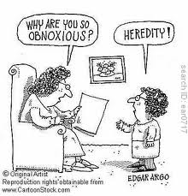
Key Point #3: Variation: In any population, there is a variation and an unequal ability of individuals to survive and reproduce.
Variation?

Slide 51
Key Point #4: Adaptation: a trait that is heritable and helps an organism survive.

Slide 52
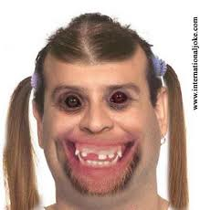
Who would you reproduce with?!
Notes:
Who would you rather reproduce with? Why? Justin bieber has traits that make him more attractive- he is good looking, famous, and has a ton of money. The other person is not physically attractive and does not appear to be rich and famous. People with desirable traits will pass on these traits to their children and reproduce.

Slide 53
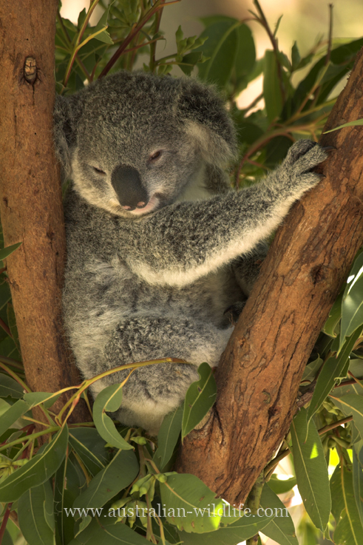
Natural Selection Question
Koalas have hands and feet that allow them to have a good grip on tree branches (they eat leaves and branches)
Is this an adaptation? Why?
Notes:
RANDOM MUTATION
YES, DUH. CUZ THE KOALA CAN SPEND MORE TIME UP IN THE TREE EATING THAT GOOD GOOD.
INCREASE
IN AN ENVIRONMENT WHERE THE KOALA WASN’T ALL UP IN THE TREE
The environment had trees with eucalyptus trees that have leaves up high. It was helpful to hang out up there because you can avoid predators on the bottom level and eat a bunch of leaves up top.

Slide 54
At the beginning of time, penguins only had webbed feet. Over time, a mutation occurred that gave penguins claws. Now, all penguins have claws and can catch fish (their food source) easier.
What is this an example of?
Notes:
An adaptation

Slide 55
Tell me what ya know!
A Lizard originally from New Orleans moved to Arizona. The lizard learned to cool himself now that he lives in the desert. This is an example of….
Notes:
Learned behavior for survival.

Slide 56
3 minute break

Slide 57
On your own…
Directions: Using your textbook, answer the following question in your notes.
Pg. 258, Compare artificial selection and natural selection.
Pg. 274-275
1, 3, 4, 16

Slide 58
Evolution Exit Ticket #6
1. Define Natural Selection:
2. Describe Darwin’s phrase, Descent with modification.
3. Give an example of an adaptation in an animal and explain why this is an adaptation.
Notes:
Good mutations
Because they help you survive
Survival of the fittest

